Slide 1
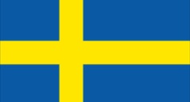
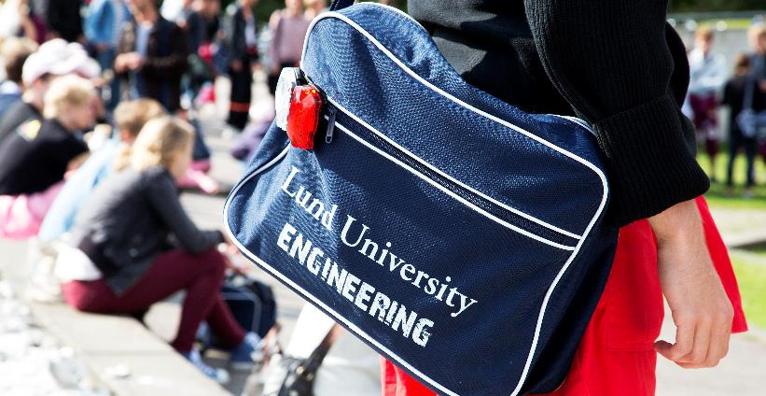
Lund University, Sweden
Lund University
2015 | EDUCATION, RESEARCH AND collaboration SINCE 1666
Education, research and innovation since 1666
Notes:
The figures for Lund University in the presentation are based on the 2014 financial year.

Slide 2
Sweden in the world

Slide 3
Numbers on Sweden
# 1 in the world exporter of chart music in relation to GDP
1% only of waste goes to a rubbish dump
89% of Swedes speak English
3rd largest country in Europe in geographical size
9.8 million people live in Sweden. 16% were born in another country
85% of Swedes live in cities
91 degrees C is the largest measured temperature variation
480 days of paid parental leave for Swedish parents
95 700 lakes

Slide 4
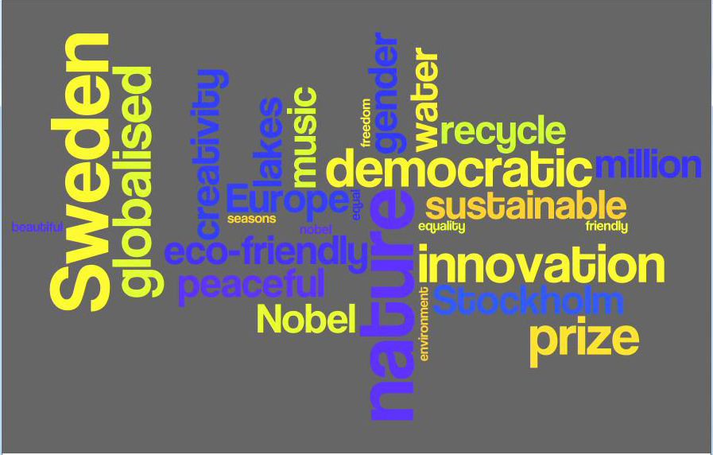
Words about Sweden
One of the...safest...most innovative...most creative...most eco-friendly...most globalised...most peaceful...most democratic… …countries in the world!
Notes:
Sweden is known for being peaceful and for being at the forefront of issues related to the environment and sustainability. The fact that Sweden in general is clean and that we sort all our garbage, make sure to recycle and can drink the tap water all over the country is something that usually impresses. Another thing that is important to highlight is the fact that people in Sweden speak English. Even though we are not all fluent, we can certainly answer when a foreigner asks for directions or needs help in other ways. Children in Sweden start studying English early on and the fact that most TV-shows and movies are in English has helped us to keep a high English proficiency level.

Slide 5
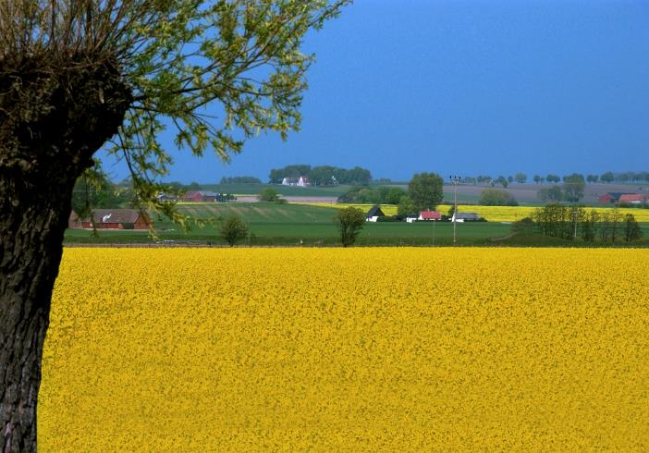
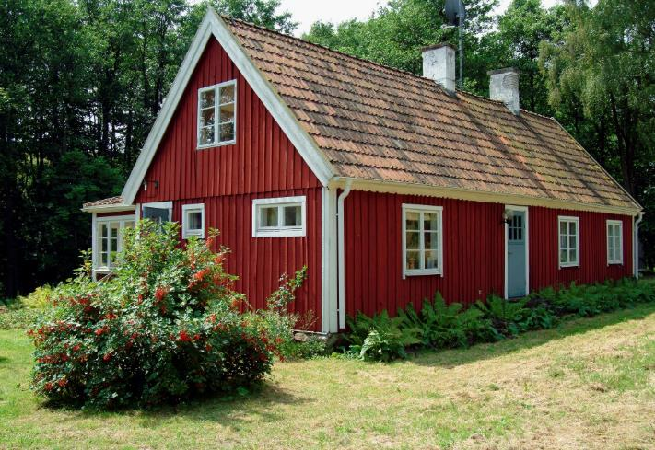
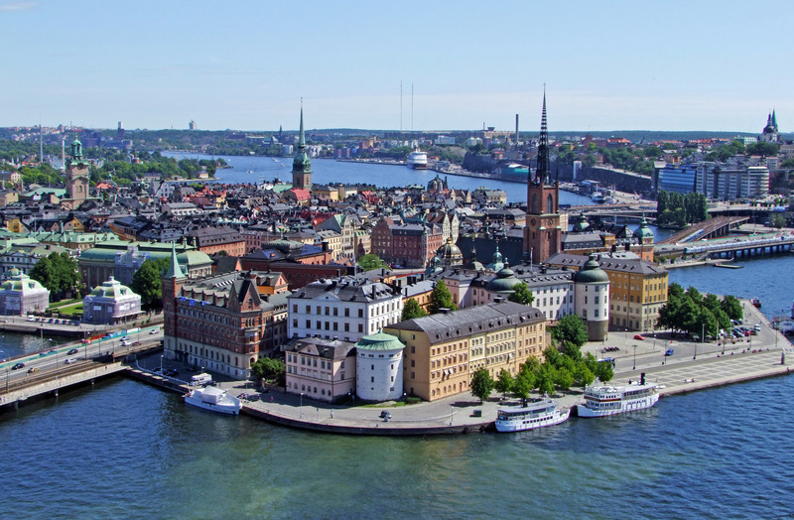
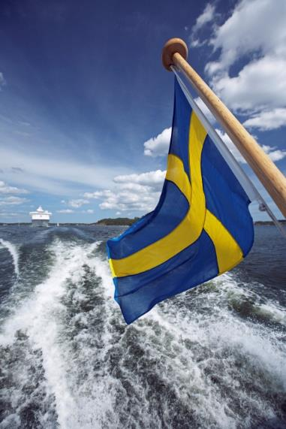
Notes:
Some photos from Sweden. The landscape varies a lot depending on where you are in Sweden. Up north there are plenty of possibilities to go skiing in winter and hiking in summer. Stockholm, the capital city, is surrounded by water and offers many sightseeing opportunities. The southern part of Sweden, where Lund is located, is flat and easily accessible.

Slide 6
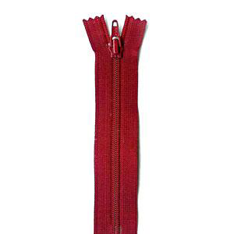
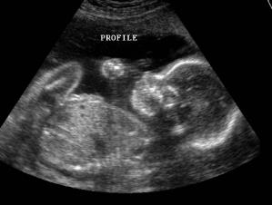
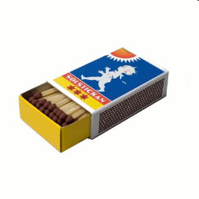
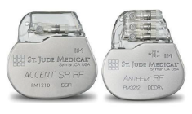
Notes:
The zipper, the wrench, safety matches, Skype, ultrasound and bluetooth technology– these are just a few examples of Swedish innovations. World-famous Swedish brands include IKEA, H&M, SKF, Sandvik, Gambro, ABB and Astra Zeneca. And a few famous Swedish people worth mentioning include footballer Zlatan Ibrahimovic, pop artist Robyn, international pop sensation ABBA and fiction writers Stieg Larsson and Astrid Lindgren. Can you name even more? Although Sweden is a small country we have managed to create a lot of world-renowned brands and innovations. The ultrasound (middle photo) and the bluetooth technology (top photo) are actually innovations from Lund University. Out of the top 100 innovative global companies in the world, nine are located in Sweden and three in Lund.

Slide 7
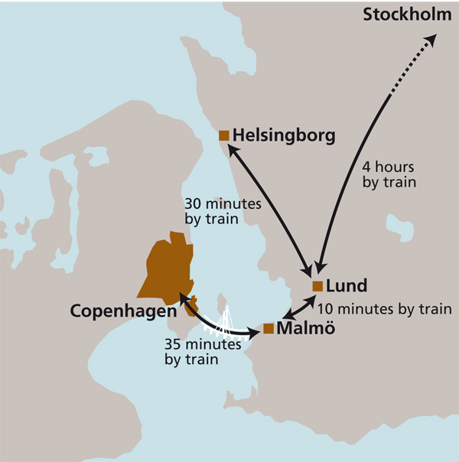
Location of Lund
Lund - Copenhagen airport 35 minutes (train) – a perfect hub for travelling in Europe
Lund - Malmö 10 minutes (train)
Lund – Stockholm 4 hours (train)
Malmö area (including Lund) is ranked the 4th most innovative region in the world (Forbes 2013)

Slide 8
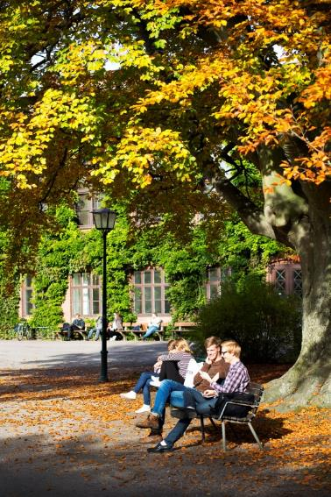
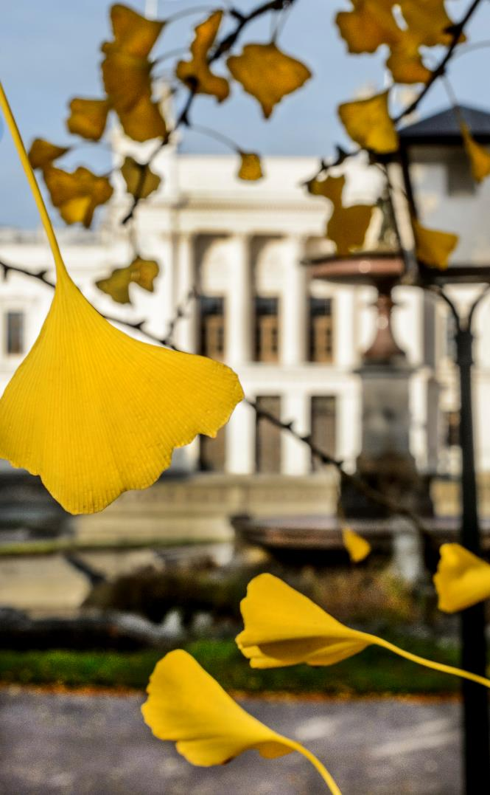
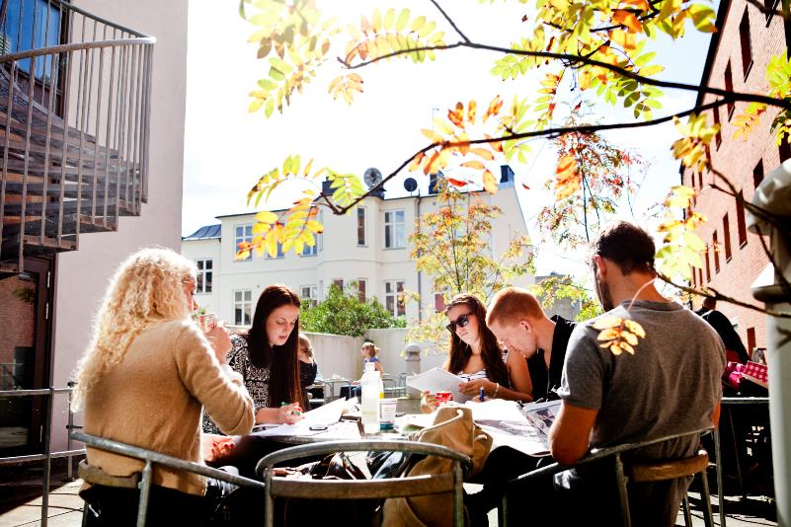
89 % of Swedes speak English, offering students an international enviroment
Notes:
Pictures from Lund

Slide 9
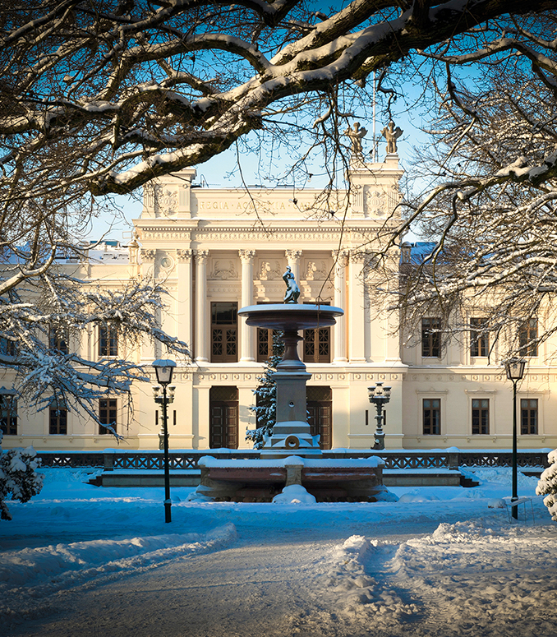
A world-class university
Founded in 1666
42 000 students (individuals/year)
>7 500 employees
830 professors
4 300 lecturers/researchers and doctoral students
Turnover EUR 833 million
- 1/3 education, 2/3 research
Notes:
The figures for Lund University in the presentation are based on the 2014 financial year.
There are around 17 000 internationally recognised universities in the world. Being ranked in the top 100, means we are in the top 0,4% of the world’s universities.
Lund University receives the most applications from international students out of all Swedish universities. This is largely due to the fact that we have a wide range of programmes offered in English and the strong research, but also to the fact that Lund is famous for its great student life.
Lund University is a public university and a public authority in Sweden. This means that there are many rules and regulations around all processes within the University to ensure high quality and a fair treatment of students and staff. Although the government in Sweden has introduced tuition fees for non-EU students, the fees are only to cover the cost of students. The universities in Sweden are not allowed to profit from the fees paid by international students. Exchange students and PhD students do not pay any tuition fees.

Slide 10
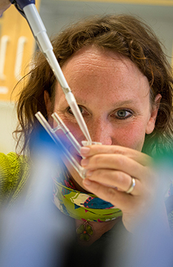
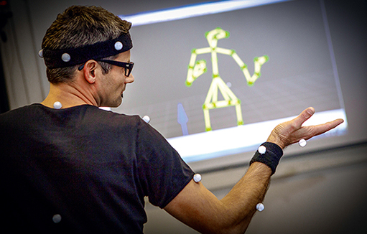
A comprehensive university – 8 faculties
Engineering
Medicine
Science
Social Sciences
Humanities and Theology
Economics and Management
Law
Fine and Performing Arts (Music, Theatre, Fine Art)
Notes:
The figures for Lund University in the presentation are based on the 2014 financial year.
Comprehensive university
Lund is the top choice in Sweden
for international students
Famous for its vibrant student life

Slide 11
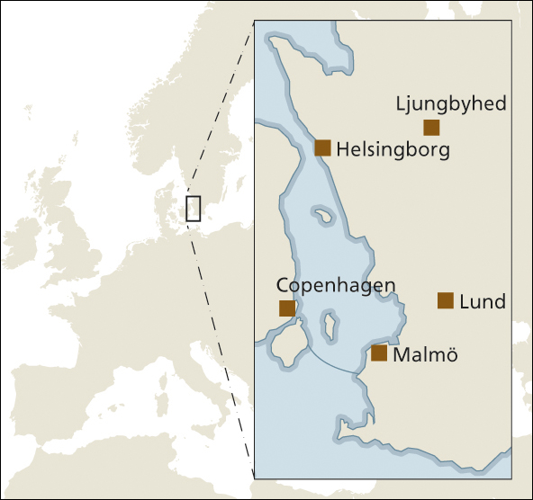
One university – multiple campuses
Lund – main campus
Malmö
Art Academy Academy of Music Theatre Academy (Parts of the Faculty of Medicine)
Helsingborg Campus Helsingborg
Ljungbyhed School of Aviation
Notes:
The figures for Lund University in the presentation are based on the 2014 financial year.

Slide 12
Strategic plan 2012–2016
Vision
A world-class university that works to understand, explain and improve our world and the human condition
Goal
Highest quality in education, research, innovation and interaction with society
Four strategies
Cross-boundary collaboration
Internationalisation
Quality enhancement
Leader, teacher and employee excellence
Notes:
The figures for Lund University in the presentation are based on the 2014 financial year.

Slide 13
World University Rankings
 | QS | THE* | Shanghai**
2014 | 60 | 119 | 101-150
2013 | 67 | 123 | 101-150
2012 | 71 | 82 | 101-150
2011 | 86 | 80 | 101-150
2010 | 72 | 89 | 101-150
* THE= Times Higher Education
** Shanghai ranking = Academic Ranking of World Universities (ARWU)
Notes:
The figures for Lund University in the presentation are based on the 2014 financial year.

Slide 14
Education – undergraduate and Master’s
Students
Individuals – total over year 42 000 ( 9 800*)
Individuals – autumn semester 30 000
Degrees awarded 7 400 (1 307*)
Education
Study programmes 276 (24*)
Free-standing 2 200 courses
* LTH
Notes:
The figures for Lund University in the presentation are based on the 2014 financial year.

Slide 15
Education – PhD
Research students
Active 3 200 (500*)
Admitted in 2014 480 (148*)
Doctoral degrees 400 (114*)
* LTH
Notes:
The figures for Lund University in the presentation are based on the 2014 financial year.

Slide 16
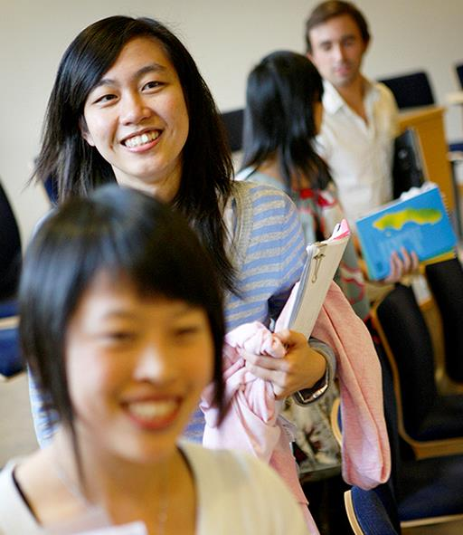
Sweden’s most international university
Exchange students (individuals) outgoing 1 180 (475*) incoming 2 120 (472*)
Non-exchange international students: 3 300
Sweden’s most popular university for Master’s degrees
* LTH
Notes:
The figures for Lund University in the presentation are based on the 2014 financial year.
International Mentor Programme
Social groups to help international students settle in and get familiar with life at LU & Sweden
3-4 mentors with groups of 15-20 students
Mentors can be Swedish or international students
Set own schedule of various social activities

Slide 17
Most popular student city in Sweden
StudentLund >20 000 members
Nations, extra-curricular social activities
Unions, monitoring of education to safeguard quality and student influence through some 1 000 representatives on all levels at LU, taking part in the leadership of the university
Academic Society (AF), operates student activities such as television, radio, ‘spex’ comedy theatre, drama, choirs and orchestras
Housed in the AF building – the physical hub of student life in Lund
Notes:
The figures for Lund University in the presentation are based on the 2014 financial year.

Slide 18
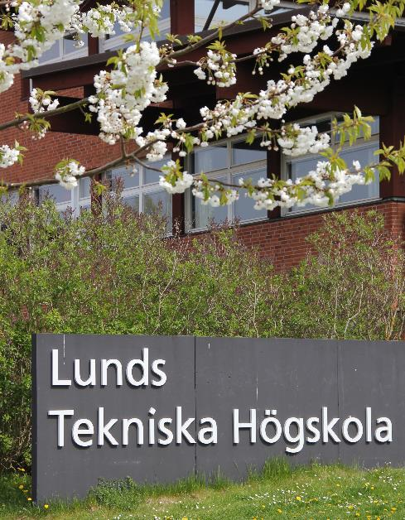
The Faculty of Engineering LTH
Founded in 1961
9 800 students
500 PhD students
1 500 employees
181 professors
Engineering, Architecture and Industrial Design
Notes:
The figures for Lund University in the presentation are based on the 2014 financial year.

Slide 19
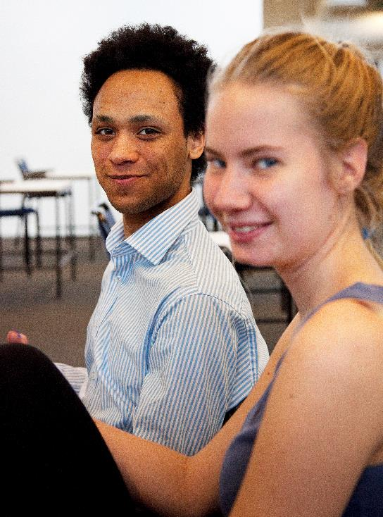
Education at LTH
5 year (3+2) integrated MSc programmes in Engineering
Master programmes (2 years) for international students
More than 400 courses suitable for exchange students
Integration between domestic and international students
Informal atmosphere
Notes:
The figures for Lund University in the presentation are based on the 2014 financial year.

Slide 20
Programmes at LTH (5 years)
Biotechnology
Computer Science and Engineering
Environmental Engineering
Electrical Engineering
Industrial Engineering and Management
Information and Communication Engineering Technologies
Chemical Engineering
Surveying and Land Management
Mechanical Engineering
Mechanical Engineering with Industrial Design
Biomedical Engineering
Risk Managment and Safety Engineering
Engineering Physics
Engineering Mathematics
Engineering Nanoscience
Civil Engineering
Notes:
The figures for Lund University in the presentation are based on the 2014 financial year.

Slide 21
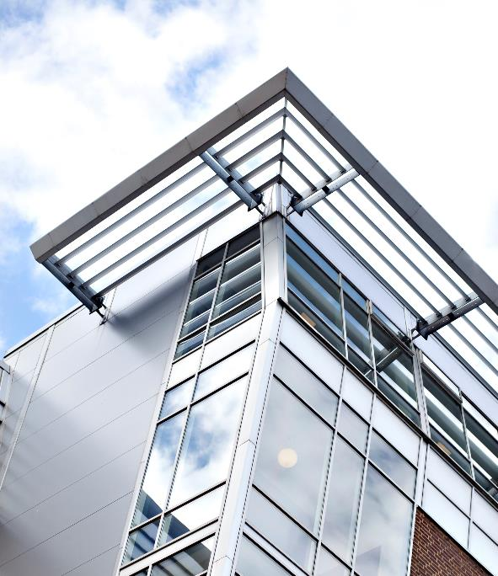
LTH programmes at Campus Helsingborg
BSc programmes (3 years)
Civil Engineering – Architecture
Civil Engineering – Railway Construction
Civil Engineering – Road and Traffic Technology
Computer Science and Engineering
Electrical Engineering – Automation

Slide 22
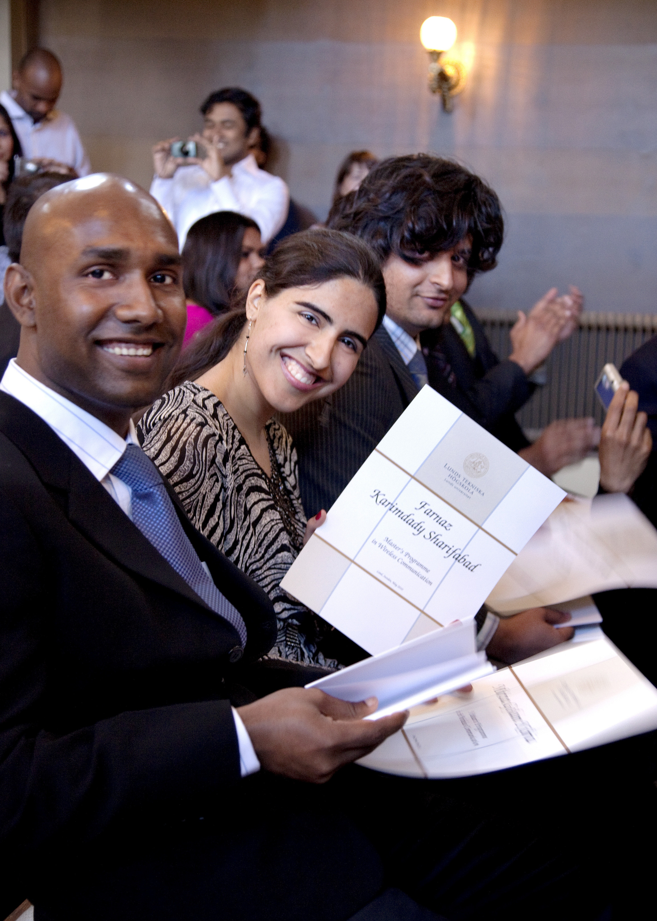
International Master’s programmes (2 years)
Architecture
Biotechnology
Disaster Risk Management and Climate Change Adaptation
Energy-efficient and Environmental Building Design
Food Technology and Nutrition
Industrial Design
Logistics and Supply Chain Management
Sustainable Urban Design
System-on-Chip
Water Resources
Wireless Communications
Fire Safety Engineering (EM)
Food Innovation and Product Design (EM)
Notes:
EM – Erasmus Mundus joint MSc programmes:
Fire Safety Engineering is offered by the Universities of Edinburgh (UK), Ghent (Belgium) and Lund (Sweden)
Food Innovation and Product Design is offered by AgroParisTech (France), Dublin Institute of Technology (Ireland), The University of Naples Federico II (Italy) and Lund University (Sweden).

Slide 23
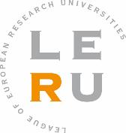
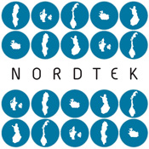
International networks
Universitas 21 (LU)
LERU (LU)
T.I.M.E. (LTH)
Magalhães (LTH)
Global E3 (LTH)
NORDTEK (LTH)
BALTECH (LTH)
CEASAR (LTH)
SEFI (LTH)

Slide 24
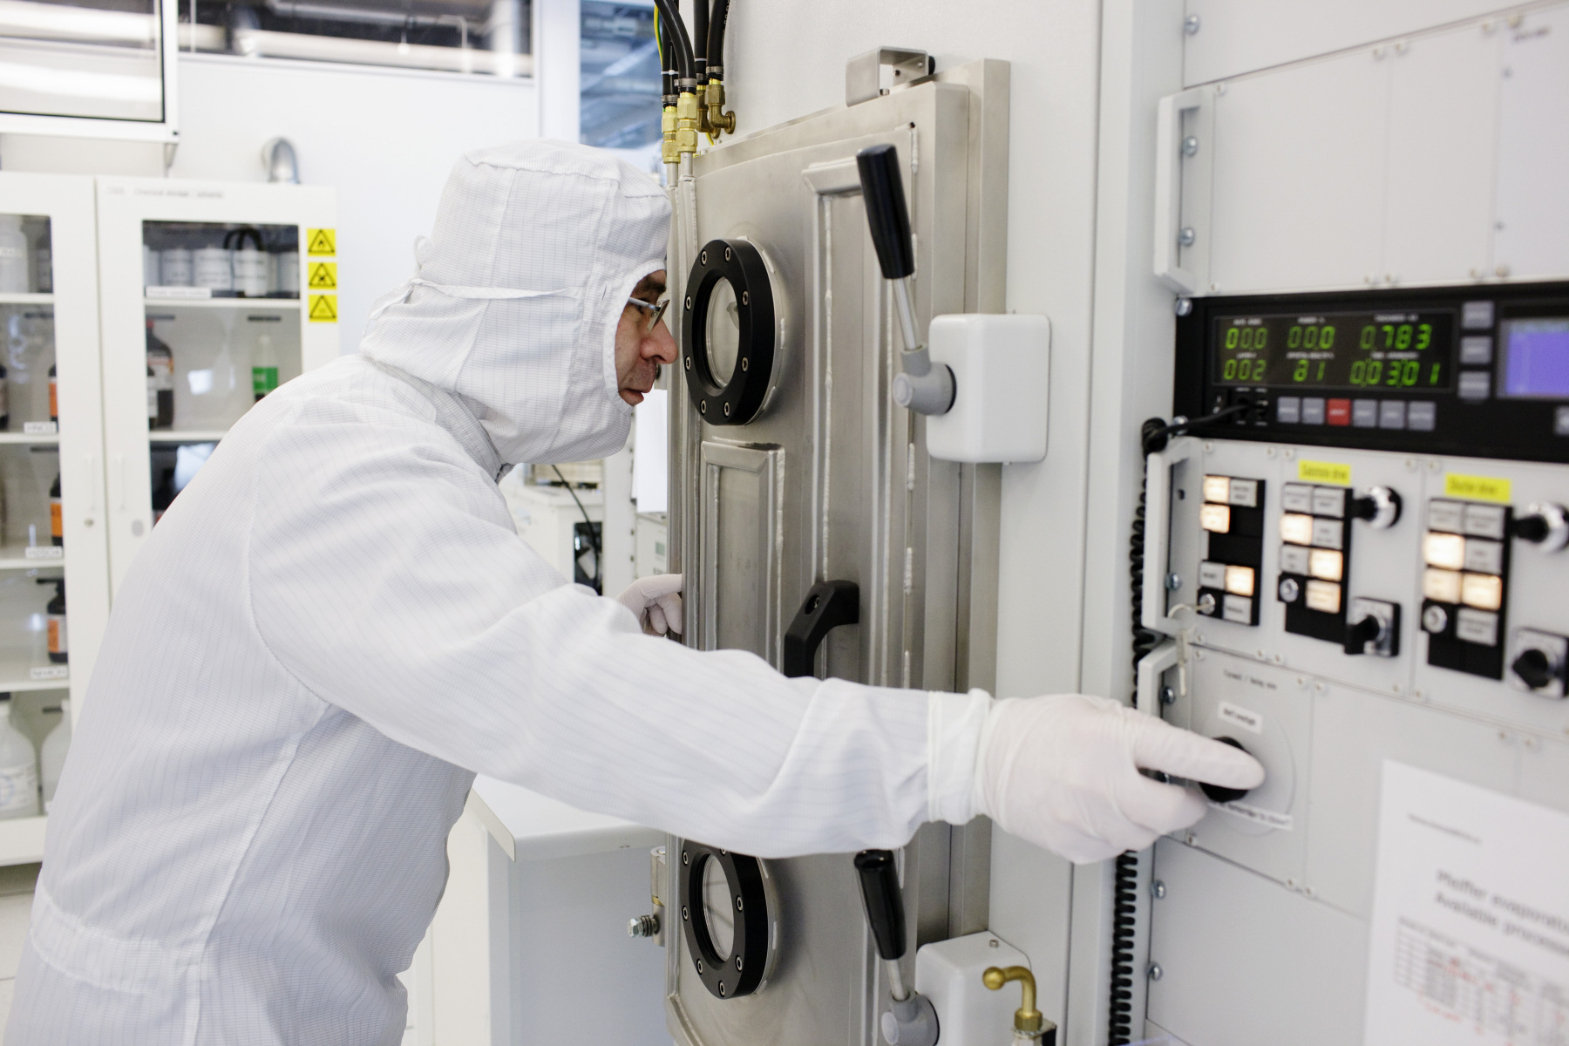
Strong research areas (LTH)
Materials science and nanotechnology
IT and mobile communication
Energy conversion
Laser physics
Automatic control
Combustion physics
Aerosol technology
Medical technology
Food technology
Transport and logistics
Risk and safety

Slide 25
LU Innovation System (LUIS)
LIUS aims to contribute to increased growth in Sweden by ensuring knowledge and research from Lund University benefits society.
Helps researchers with business development, financing, patents, networking, legal issues, etc.
Utilisation through:
Patenting and licensing
Formation of companies
Knowledge services
Notes:
Lund University’s innovation system helps to turn research into products and services that are useful to society.

Slide 26
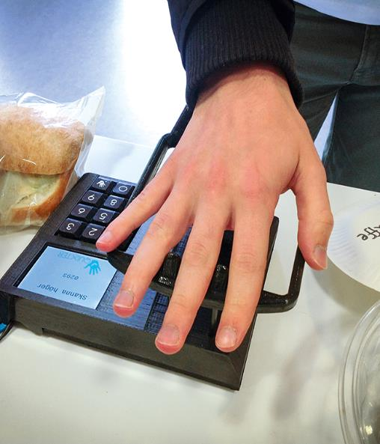
Innovation outcomes 2014
New innovation ideas 119
Commercialisation projects 84
Patent applications 16
Companies formed 15
with holding company as
a part-owner 5
Notes:
The figures for Lund University in the presentation are based on the 2014 financial year.

Slide 27
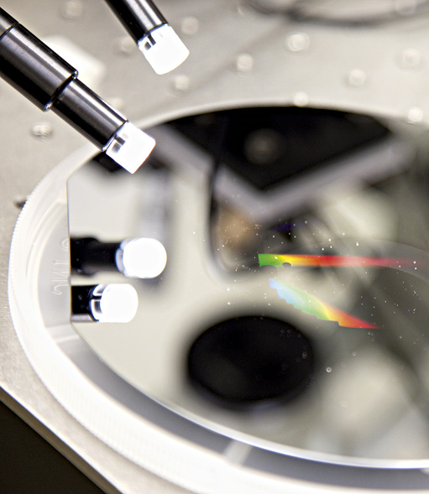
Innovation outcomes since 1999
Investments in over 70 new research companies
Over 2 800 full-time equivalent jobs
Around EUR 85 million in tax revenue
Notes:
The figures for Lund University in the presentation are based on the 2014 financial year.

Slide 28
Innovations: some examples
Diagnostic ultrasound
Proviva – fruit drink with lactic acid bacteria
Oatly – probiotic oatmeal drink
Freshness in vegetables after freezing
Energy efficient LEDs
Cancer treatment using lasers
Bluetooth
Hövding – airbag helmet for cyclists
Treatment for pre-eclampsia
Solar cells using nanotechnology

Slide 29
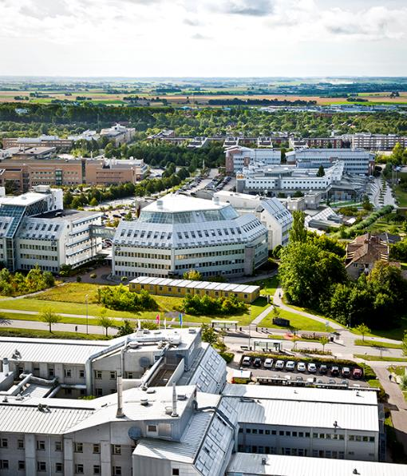
An entrepreneurial university
Integration of entrepreneurial perspectives into Master’s programmes and graduate schools
All faculties included
IKS – joint innovation office for all HE institutions in southern Sweden
Ideon Science Park – 350 companies, the majority of which have their origins in research from Lund University
Notes:
The figures for Lund University in the presentation are based on the 2014 financial year.
29

Slide 30
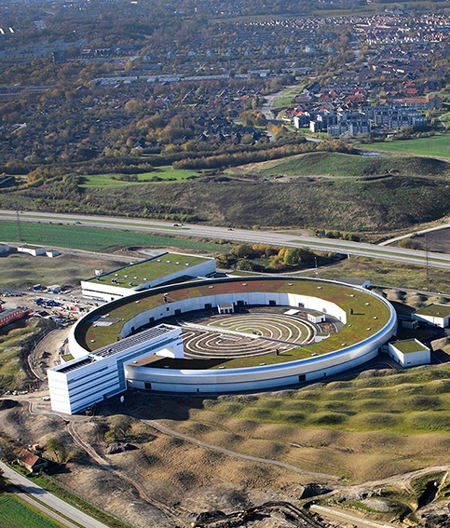
The MAX IV Laboratory
World-leading synchrotron radiation laboratory
Using synchrotron radiation to study materials at the atomic scale
For scientific breakthroughs within medicine, engineering and science
Inauguration 2016
Notes:
MAX IV will be inaugurated on 21 June at 1.08 pm (the brightest time of year)
ESS and MAX IV complement each other and can thus create significant synergy effects. The new centre will be world-leading in materials science and form a hub in the European research infrastructure.

Slide 31
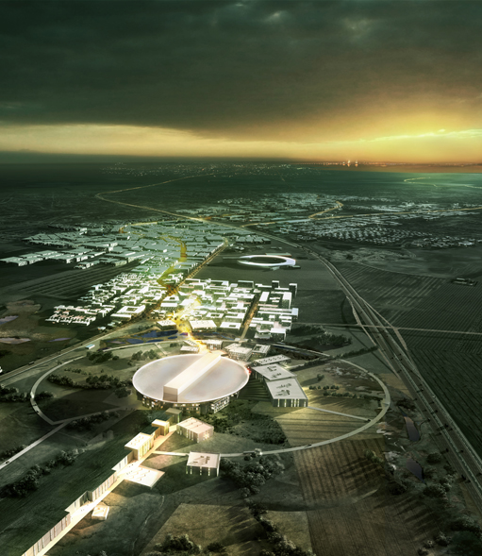
ESS – European Spallation Source
A world-leading facility for neutron science
Will be used to study the atomic and molecular structure and function of materials such as plastics, proteins and medicines
First neutrons in 2019, fully completed in 2025
Will be used by at least 17 European countries
Notes:
ESS and MAX IV complement each other and can thus create significant synergy effects. The new centre will be world-leading in materials science and form a hub in the European research infrastructure.

Slide 32
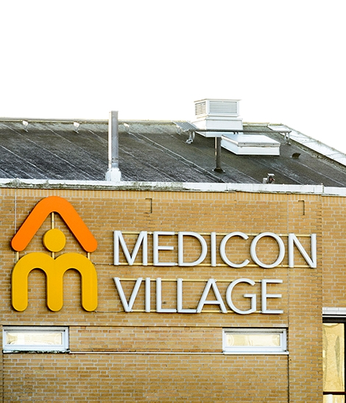
Medicon Village – A science and business park for life science
Research, innovation and enterprise working together to create value for human health and wellbeing
Cancer, Diabetes, Nano Medicine and more
Initiated by Lund University in a triple helix collaboration
Opened 2012 in AstraZeneca’s former premises
February 2015:
1.100 persons
More than 100 companies/organisations

Slide 33
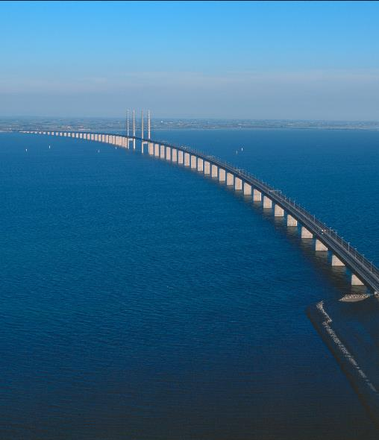
The Öresund region: one of the world’s strongest research regions
The highest concentration of highly-qualified workers in northern Europe
12 universities
155 000 students
12 000 researchers
A hub for ideas, science and culture
A large proportion of the business sector has its origins in research
International airport (Copenhagen)

Slide 34
Cultural and Public Centres
Skissernas museum
Unique in the world, with focus on the creative process and art in public spaces
The Botanical Garden
7 000 plants and a green-house with nine climate zones
The Historical Museum
Southern Sweden’s largest archaeological museum
Odeum
Centre for music making, concerts and lectures

Slide 35
Notes:
The figures for Lund University in the presentation are based on the 2014 financial year.

