Slide 1
The student template in brief
The first page in the template is a page you can use (make sure that page has no notes!) in the event of technical difficulties.
If you are to publish your presentation on Canvas, the law requires you to make it accessible.
Adapting for accessibility is important as it enables people with different abilities to participate fully.
On the first pages of the template is "title, your name and student at programme x" which you must fill in. In the menu View> Image background you can edit the text. Here you can also change the image if you want. It is important that it is clear that you as a student are the author and not the faculty.

Slide 2
Check and adjust
When your document is ready, check its structure via Check accessibility under the Review tab. Make the adjustments according to the instructions. This includes entering alt text for all images which are not merely decorative. Proceed as follows:
Rightclick the image and select Edit alternative text (Size and position in older versions of Powerpoint).
Enter an objective description of the image.

Slide 3
Check and adjust, continued
If you have entered new text boxes and other items, these often need to be adjusted to end up in the right reading order. Go through all pages and adjust them according to the instructions you receive in the check.
Also enter the document title and author in the document info you find under Archive > Properties (this may vary according to different versions of the program).
Images without text must also have a title. A field for this is located at the top, outside the page itself. You may need to zoom out a little bit to see the field.

Slide 4
In case of technical issues.

Slide 11


Slide 12


Slide 13


Slide 14

Message statement of maximum three to four lines here.

Slide 15
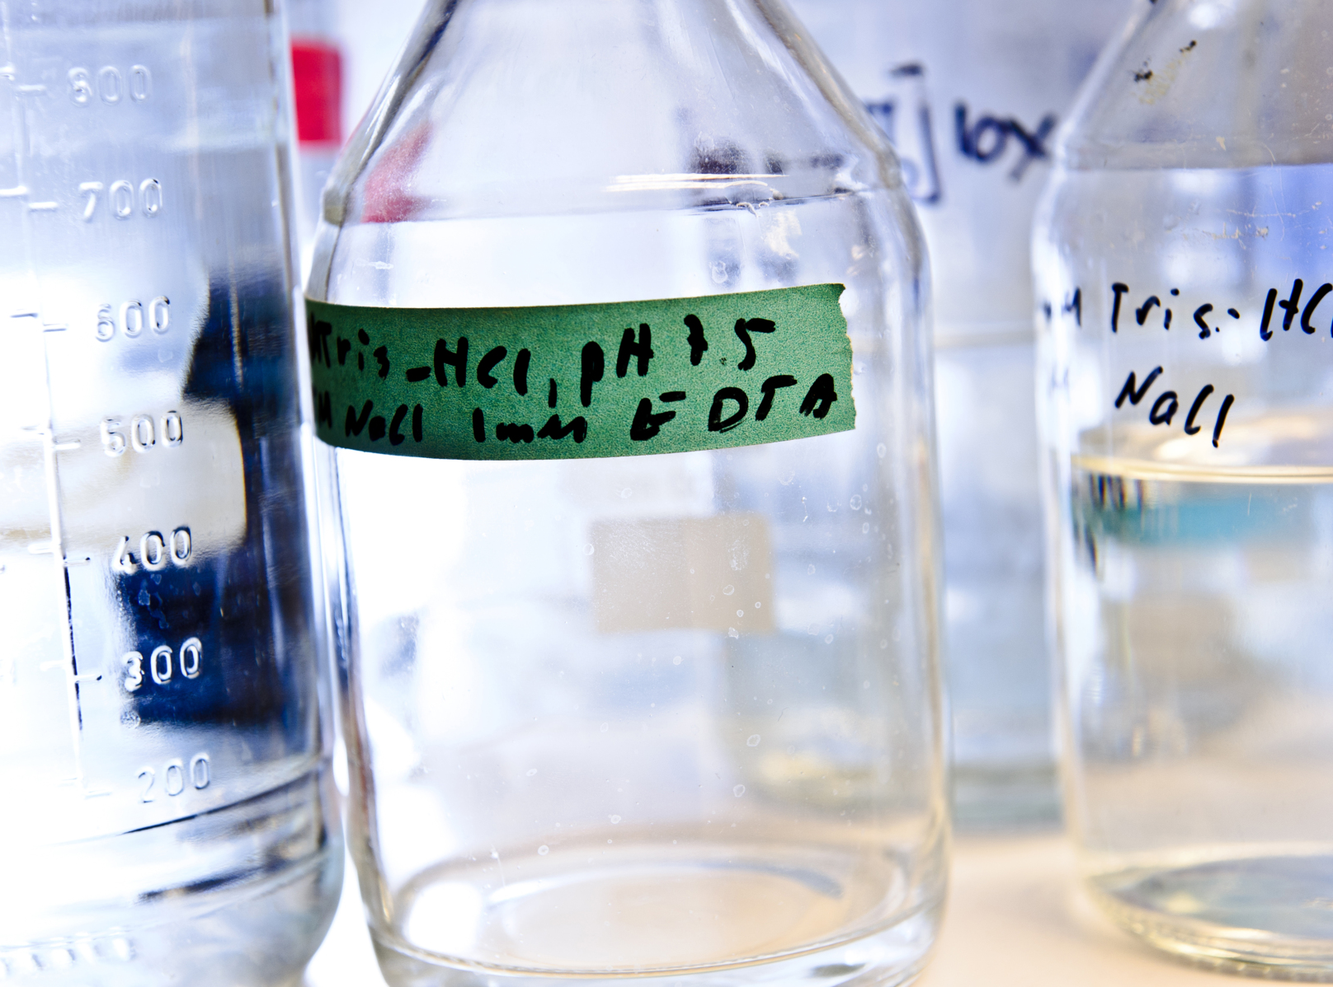
Message statement of maximum two to three lines here.

Slide 16


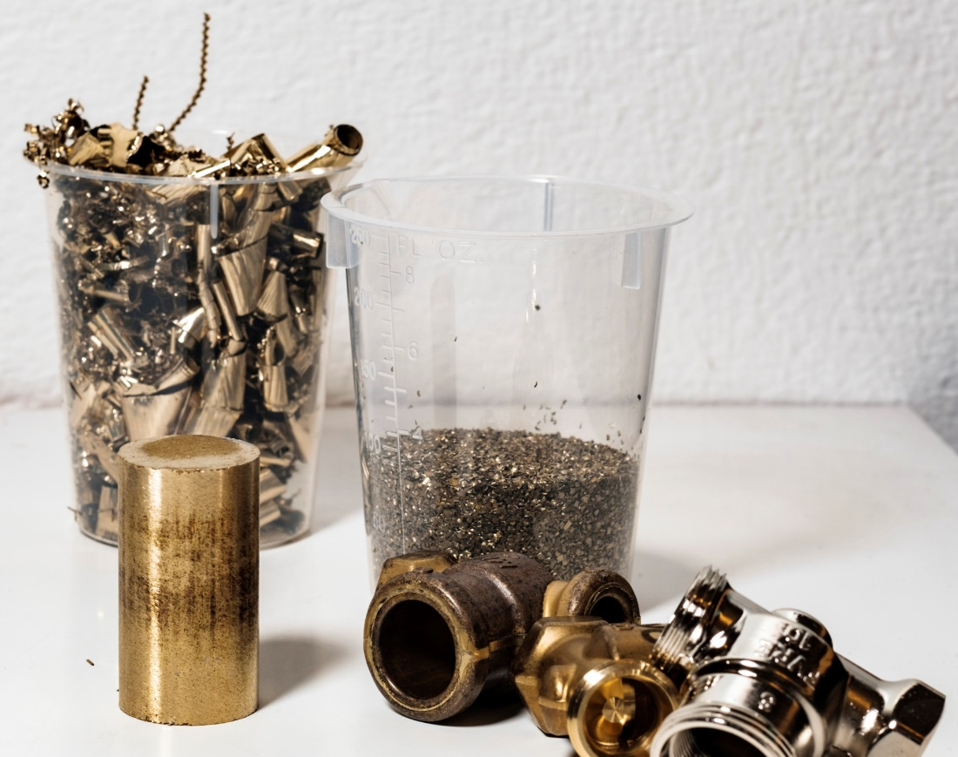

Slide 17
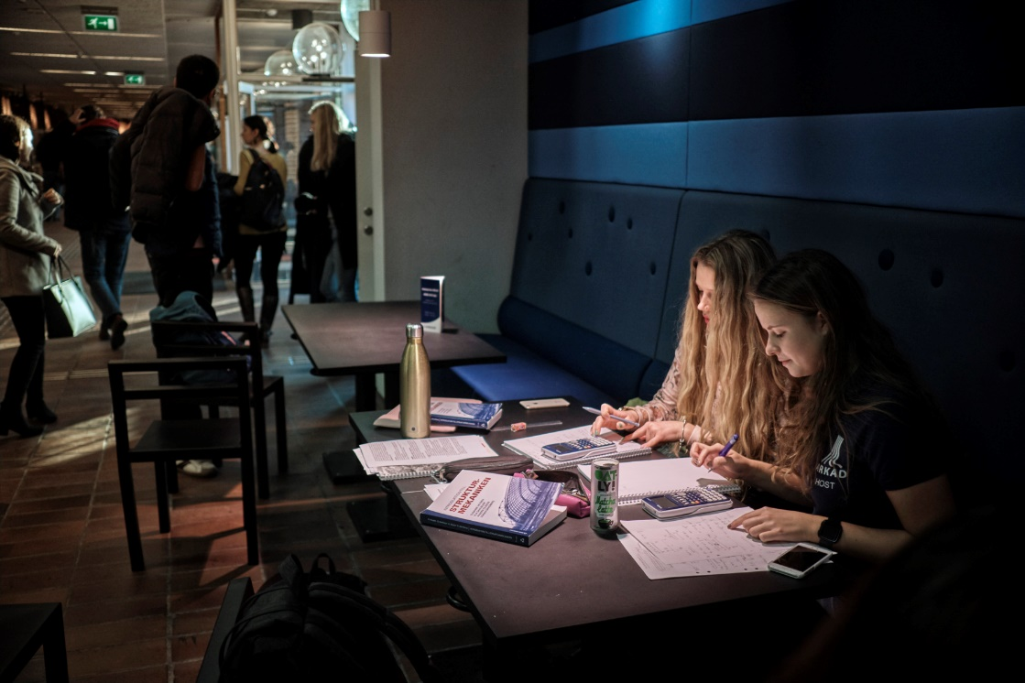
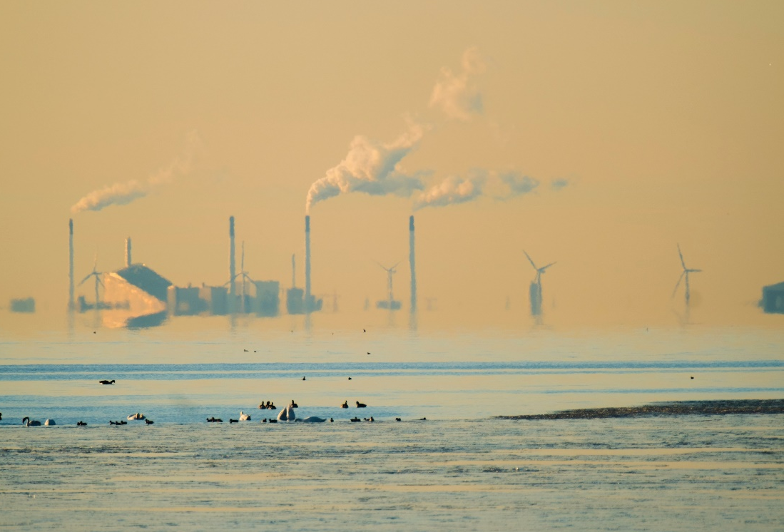
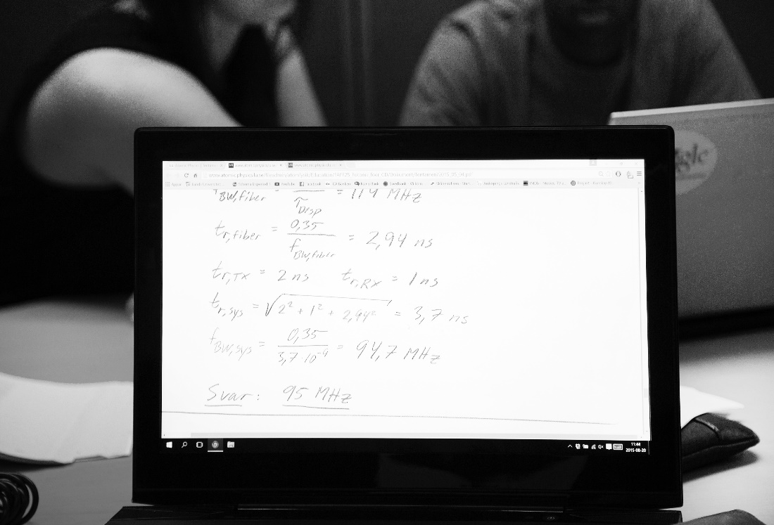
Writing tips and image examples
Being careful with grammar and punctuation affects your credibility and ability to engage your audience.
What should the audience take away from your presentation? Write a good heading! For example: “Wash hands thoroughly” rather than “Recommendation”.
You are welcome to use the images used in this template (from LTH's image database). You can find free images at www.unsplash.com, www.pixabay.com and www.pexels.com

Slide 18


Slide 22
Quotation marks require a left-justified text.
The quotation marks and text box almost always need readjusting, depending on the length of the text.
The quotation mark is always to align with the top edge of the text.

Slide 23






Slide 24



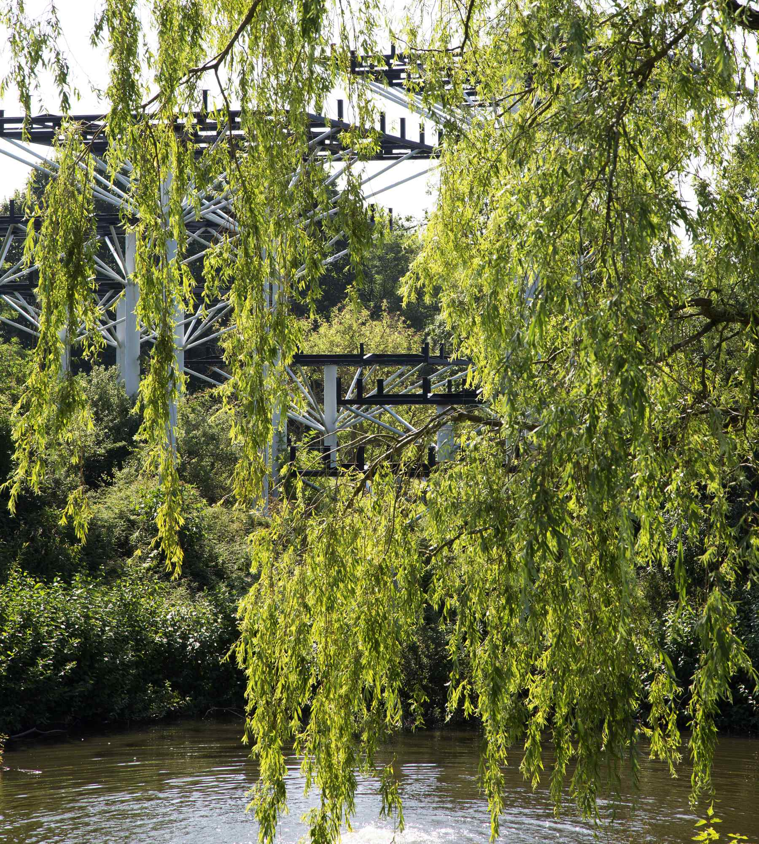

Collage, environments and objects at LTH.

Slide 25
 | QS | THE | Shanghai
2016 | 73 | 96 | 101–150

Slide 26
For accessibility, the use of more than colour is required in order to distinguish the different diagram fields.
Here, black and white bars have been complemented with outlines in the opposite colour to provide contrast. If there are several fields, patterns may need to be used.

Slide 28
Put explanation texts outside the pie chart if they are long.

