Slide 1
ABOUT LiL AND SwedenBIO
LiL- Läkemedel i Lund / Pharmaceutical Research at Lund University
LiL was founded in 2009 as a joint initiative between the three faculties of Medicine, Science and LTH at Lund University. Our intention is to provide an information exchange platform for pharmaceutically related activities in a broad sense, where issues relevant for both academic- and industrial research and development can be discussed. Our science-related activities today include a yearly SYMPOSIUM and research-edge-oriented SPOTON seminars. Networking and careerplanning events are provided at PROWEB meetings.
Homepage: www.lu.se/lil
Contact: Sofi Elmroth, PhD, Docent, Coordinator LiL
Tel: 046 - 222 3692
Email: sofi.elmroth@biochemistry.lu.se
SwedenBIO
SwedenBIO is the national organization working for the benefit of the entire life science industry in Sweden. SwedenBIO is a member driven, private non-profit organization. The main objective is to improve and maintain industry conditions which will support prosperous growth and business development among our, today, close to 200 member companies. Our members are active in all sectors ranging from pharmaceuticals, biotech, medtech to diagnostics. Our mission is to create visibility and interest for the Swedish life science industry and thereby support a successful life science industry. A successful industry can heal and help those patients still suffering from unmet medical needs. A successful industry creates jobs and welfare and creates opportunities for a healthier and brighter future.
Homepage: www.swedenbio.com
Contact: Sara Gunnerås, PhD, Senior Manager Science and IP
Tel: 08 – 21 36 02
Email: sara.gunneras@swedenbio.com

Slide 2

A joint initiative between LiL-Läkemedel i Lund and SwedenBIO
3rd SYMPOSIUM, February 8, 2012
Methods and Molecules
TIME: 9.30 – 17.00
PLACE: Medicon Village,
Scheelegatan 2, Lund

Slide 3
9:30 REGISTRATION
10:00 – 12:00 Session 1
10:00 Welcome
Sofi Elmroth, LiL, Lund University, Sara Gunnerås, SwedenBIO
10:05 Medicon Village
Mats Leifland VD, MV
10:25 Life Science Foresight
Paula Zeilon, Managing Director, LSF
10:45 LTH - Medicin och Teknik
Leif Sörnmo, Lund University
11:05 Developments in cancer diagnostics in the era of personalized
medicine
Rolf Ehrnström CSO, DAKO
12:00 – 13:00 LUNCH & POSTERS
13:00 – 14:40 Session 2
13:00 Pharmaceutical companies challenge with companion
diagnostics commercialization
Paula Boultbee, Senior Advisor, Monocl
13:40 LBIC (Lund University BioImaging Center) for small animal
imaging techniques in drug development and cancer
diagnostics
Thuy Tran and Sven-Erik Strand, Lund University
14:10 The potential of miRNA in cancer diagnostics and cancer
prognostics
Yvonne Ceder, Lund University

Slide 4
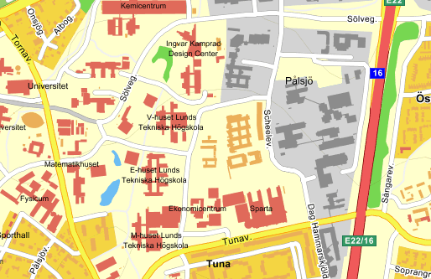
14:40 – 15:30 COFFEE & POSTERS
15:30 – 17:00 Session 3
15:30 Biomarkers and companion diagnostics – How to achieve
efficacy in the right patients
Kristina Forsman-Semb Sales and Marketing Director, Co-funder, Truly Translational
15:55 Antibody-based disease proteomics
Christer Wingren, Lund University
16:20 Panel discussion
Roland Andersson, Region Skåne
Rolf Ehrnström, CSO, DAKO
Carlos Rovira, Lund University
Christer Wingren, Lund University
17:00 END OF DAY
P

